Slide 1

If you step into the drug world
(most often with alcohol or Marijuana)
your life path changes…

Slide 2
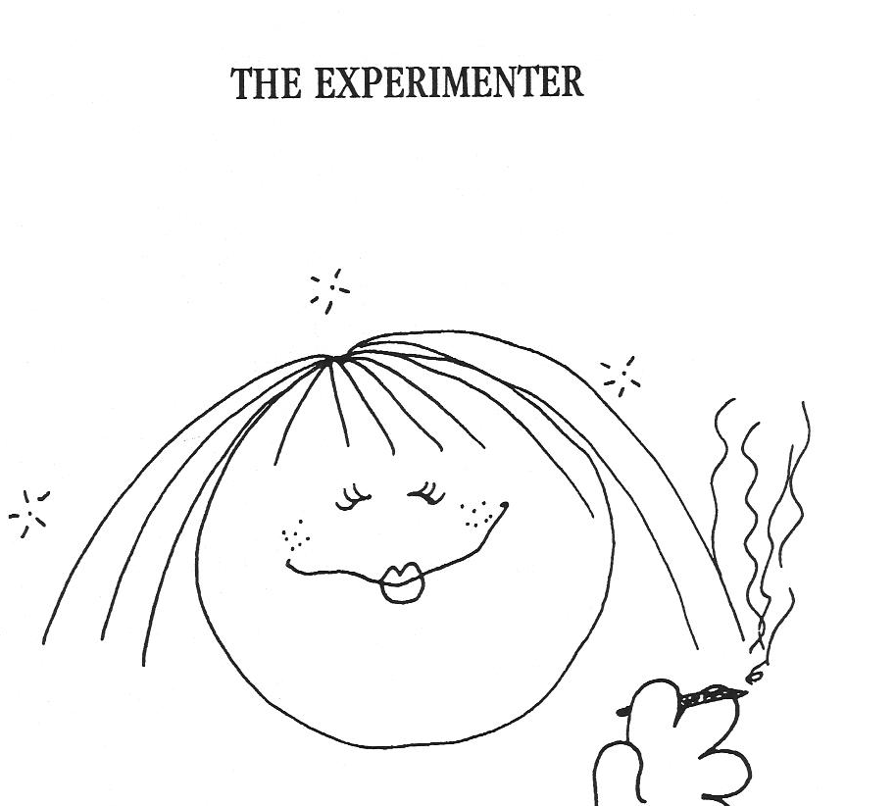
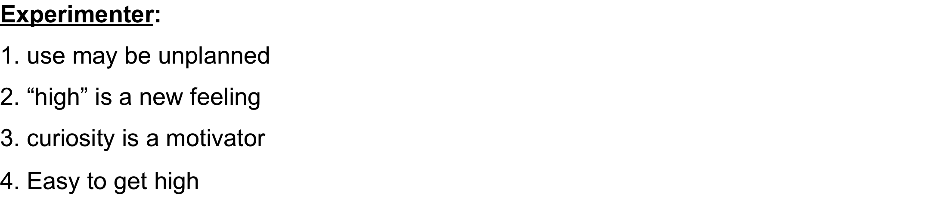
Levels of Addiction:
1. Experimentation
1
page 12

Slide 3
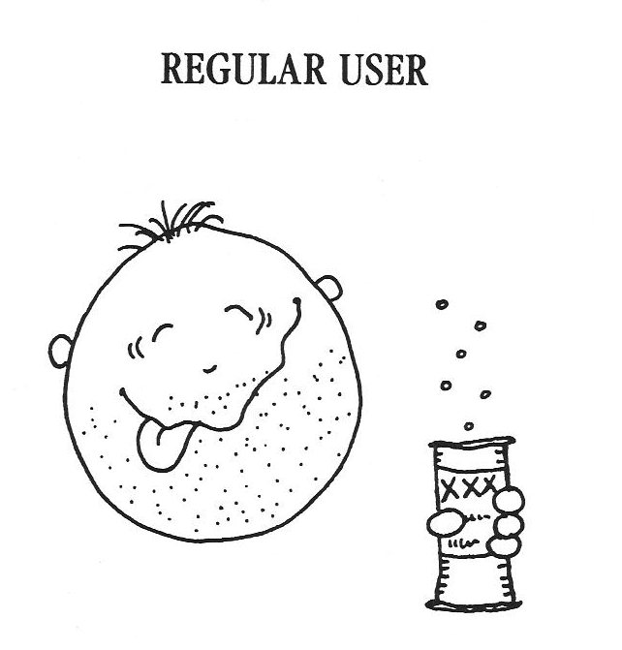
2. Regular Use
1. makes plans to get high
2. more things include drugs
3. lying to parents
4. chooses friends who use
page 12
Notes:
Regular User:
1. makes plans to get high
2. more things include drugs
3. lying to parents
4. chooses friends who use

Slide 4
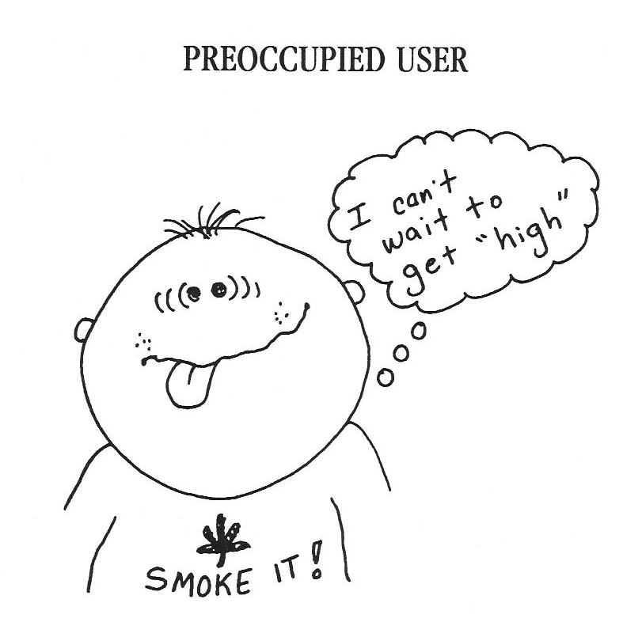
DAILY PREOCCUPATION
3
1. becoming high
becomes normal
2. may have blackouts
3. can’t cut down or quit
4. uses alone
page 12

Slide 5
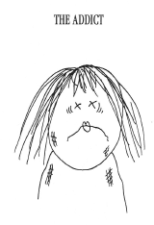
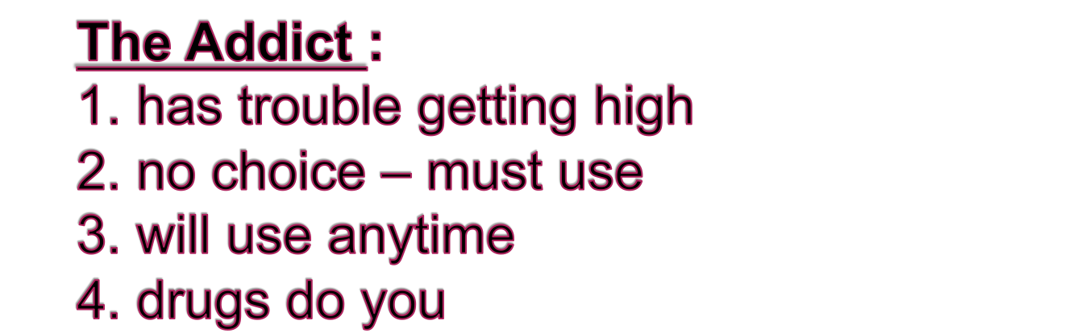
4. DEPENDENCY
page 12

Slide 6
Drugs will take you places you never thought you'd go
...

Slide 7
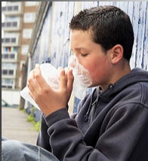
and change who you are.

